Slide 1
The video for this presentation can be found here
Notes:
The video for this presentation can be found here:
https://channel9.msdn.com/Events/Connect/2017/G104

Slide 2
Developer tools for app innovation
Julia Liuson
CVP, Developer Division Microsoft

Slide 3


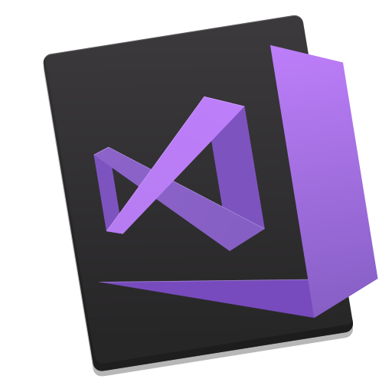


THE VISUAL STUDIO FAMILY IS GROWING
Visual Studio
6 million users
Visual Studio Code
2.6 million users
Visual Studio for Mac
Grew 230% since launch
Visual Studio Team Services
Grew 40% YoY
Visual Studio App Center
General availability today!
Best-in-class tools for any developer

Slide 4
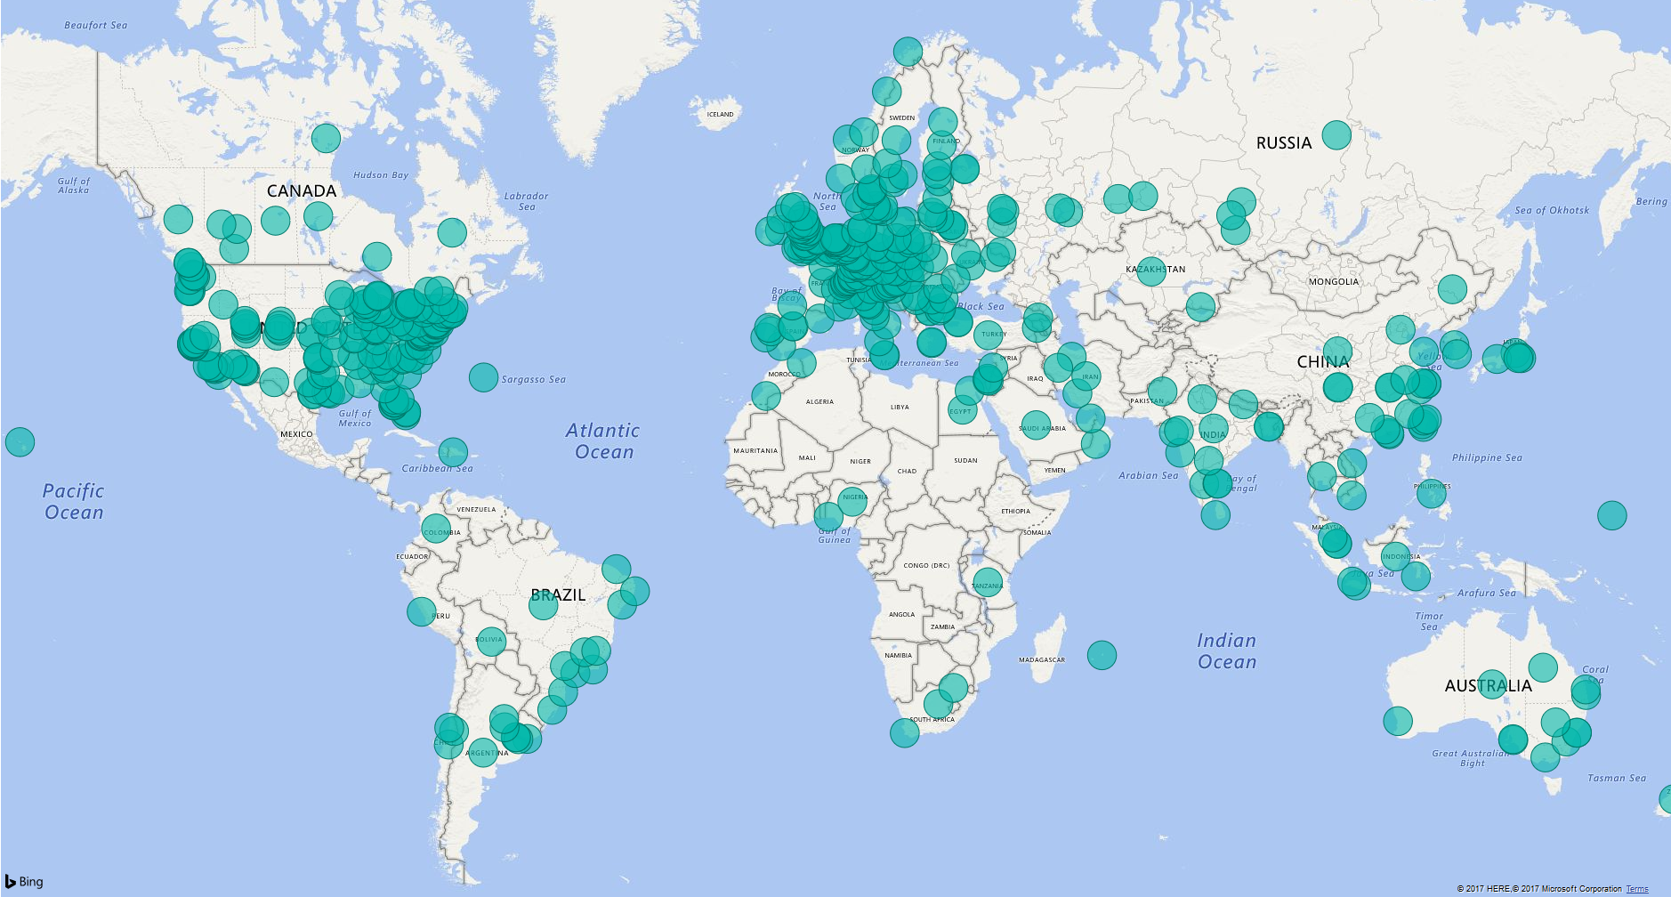

Slide 5







TECHNICAL STEERING GROUP MEMBERS
And community contributions from over 1700 companies
Notes:
Perhaps our best-known contribution to open source -- though, frankly, we’d like to get the message out to more people that it *is* open source – is .NET.
.NET is growing rapidly, we have 4M active developers. We get about 450K new developers/Month and we see a 15% growth in Community PR’s MoM.

Slide 6


Tencent – WeChat Pay

Slide 7
VISUAL STUDIO
OPEN
PRODUCTIVITY
TEAM

Slide 8
OPEN
Notes:
Develop across platforms with a strong ecosystem of open source

Slide 9
Demo
Daniel Moth

Slide 10
DEMO RECAP
Announcing: Python extension for Visual Studio Code

Slide 11
VISUAL STUDIO
OPEN
PRODUCTIVITY
TEAM

Slide 12
PRODUCTIVITY

Slide 13
PERFORMANCE FOR C++ SCENARIOS
Visual Studio 2015
Visual Studio 2017
Memory usage (Chromium)
30%
2,293 MB
804 MB
804 MB
Find all references (on C++ symbol in Chromium)
4.7x
429s
91s
C++ Rename refactoring (in Chromium)
5.3x
562s
106s
C++ Solution Open (Chromium, 3500+projects)
18x
1,211s
68s

Slide 14
Video Real-time test discovery Before and after
Notes:
This is Visual Studio 15.4 compared with 15.5 when opening a project with 10,000 tests.
Previously you had to build your project for discovery to start.
On the right in 15.5, we see that discovery started automatically.
I can even add a new test and run it immediately.
15.4 on the left side will still need another minute to complete.
The only qualifier is that you must have the Real Time Test Discovery feature flag turned on for it to work this way. It won’t be turned on out of box. The project does not need to be built because test discovery actually happens through a Roslyn analyzer. (We used to need the project assemblies to discover tests.)

Slide 15
PRODUCTIVITY

Slide 16
Demo
Kaycee Anderson

Slide 17
DEMO RECAP
Continuous Integration & Delivery pipeline
Announcing: Step-back debugging
Snapshot debugging
Azure Functions in Visual Studio for Mac

Slide 18
VISUAL STUDIO
OPEN
PRODUCTIVITY
TEAM

Slide 19
TEAM
COLLABORATION
Notes:
At Microsoft, we’ve been working on the fastest inner loop so that we can deliver innovation at velocity with confidence. The first piece is to facilitate the most productive collaboration between team members so you can iterate as quickly as possible and learn from each other as you develop. The second piece is to separate our architecture into independent microservices and leverage infrastructure we’ve built which allows developers to move independently while working on a large app as a team. Lastly, we move quality and validation as early in the development lifecycle as possible. As we make our own dev cycles faster, we turn these best practices into our tools platform so that your teams can benefit from this dev lifecycle too.
I’d like to welcome Amanda Silver and Scott Hanselman to give you a glimpse of the developer productivity that will be speeding up you and your teams soon…

Slide 20
Demo
Amanda Silver
Scott Hanselman

Slide 21
WEB FRONTEND
REPL
VERIFICATION
Notes:
Used by Scott Hanselman in his demo
Kick off this part with an architectural overview so folks understand 3 services and how they interact with each other.

Slide 22
AMANDA
REPL
SCOTT
WEB FRONTEND
VERIFICATION
REPL
SCOTT’S VERSION
Notes:
Kick off this part with an architectural overview so folks understand 3 services and how they interact with each other.

Slide 23
DEMO RECAP
Visual Studio Live Share aka.ms/vsliveshare
Visual Studio Connected Environment for AKS aka.ms/signup-vsce

Slide 24










BEST-IN-CLASS TOOLS FOR ANY DEVELOPER
Linux
macOS
Windows
iOS
Android
Clojure | CoffeeScript | Go | Groovy | React Native | Objective-C | Perl | PHP | Ruby | Rust | Swift
Notes:
We’ll continue to fill out scenarios so that we have tools for Any Developer, building Any App on Any Platform.

Slide 25
visualstudio.com
@visualstudio + @code

